Slide 1
Abhijnanasakuntalam
Kalidasa
Presented by:
Jaspal Kaur Matharu
Guest Faculty
Department of English
Gangadhar Meher University

Slide 2
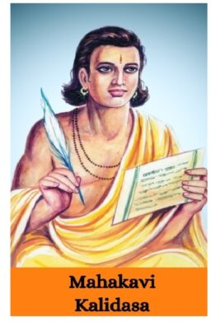
Kalidasa
Kalidasa, (flourished 5th century CE, India), Sanskrit poet and dramatist, probably the greatest Indian writer of any epoch.
The six works identified as genuine are the dramas
Abhijnanashakuntala (“The Recognition of Shakuntala”)
Vikramorvashi (“Urvashi Won by Valour”)
Malavikagnimitra (“Malavika and Agnimitra”)
The Epic Poems
Raghuvamsha (“Dynasty of Raghu”)
Kumarasambhava (“Birth of the War God”)
The Lyric
“Meghaduta” (“Cloud Messenger”)

Slide 3
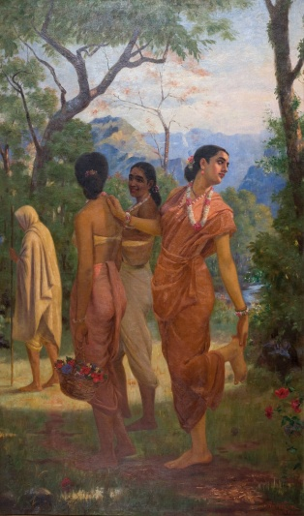
Abhijnanasakuntalam
Abhijnanashakuntalam also known as Shakuntala, The Recognition of Shakuntala is a Sanskrit play by the ancient Indian poet Kalidasa, dramatizing the story of Sakuntala told in the epic Mahabharata and regarded as best of Kalidasa's works. Its exact date is uncertain, but Kālidāsa is often placed in the 4th century CE.
The title is sometimes translated as the token-for-recognitionof Sakuntala or The Sign of Sakuntala. The story of Sakuntala is initially mentioned in the Mahabharata.

Slide 4
Characters
Shakuntala
Meghadūta
Durvasas
Gautami
Anasuya
Vidusaka
Abhigyan Shakuntalam
Kanva
Kumārasambhava
Priyamvada
Dusyanta
King Dushyanta
King dusyanta
Menaka
Caturika
Chamberlain
Sanumati
Mātali
Romila Thapar

Slide 5
Plot
The protagonist is Shakuntala, daughter of the sage Visvamitra and the apsara Menaka. Abandoned at birth by her parents, Śakuntalā is reared in the secluded hermitage of the sage Kanva, and grows up a comely but innocent maiden.
While Kaṇva and the other elders of the hermitage are away on a pilgrimage, Dusyanta, king of Hastinapur, comes hunting in the forest. Just as he was about to slay a deer, Vaikhānasa, a sage obstructs him saying that the deer was from the hermitage and must not be slayed. He politely requests the king to take his arrow back, to which the king complies. The sage then informs him that they are going to collect firewood for the sacrificial fire and asks him to join them. They then spot the hermitage of Sage Kaṇva and decide to pay the hermits a visit. However the king decides to go to this penance grove dressed up as a commoner. He also stops the chariot farther away to not disturb the hermits. The moment he enters the hermitage and spots Śakuntalā, he is captivated by her, courts her in royal style, and marries her. Soon, he has to leave to take care of affairs in the capital. The king gives her a ring which, as it turns out, will eventually have to be presented to him when she appears in his court to claim her place as queen.

Slide 6
One day, the anger-prone sage Durvasa arrives when Śakuntala is lost in her thoughts, and when she fails to attend to him, he curses her by bewitching Duṣyanta into forgetting her existence. The only cure is for Śakuntala to show the king the signet ring that he gave her.
She later travels to meet him, and has to cross a river. The ring is lost when it slips off her hand as she dips it in the water playfully. On arrival the king is unable to recognize the person he married and therefore refuses to acknowledge her. Śakuntala is abandoned by her companions who declare that she should remain with her husband. They then return to the hermitage.
Fortunately, the ring is discovered by a fisherman in the belly of a fish, and presents it in the king's court. Duṣyanta realizes his mistake - too late. The newly wise Duṣyanta is asked to defeat an army of Asura, and is rewarded by Indra with a journey through heaven. After returning to Earth years later, Duṣyanta finds Śakuntala and their son by chance, and recognizes them.
In other versions, especially the one found in the ‘Mahabharat', Śakuntala is not reunited until their son Bharata is born, and found by the king playing with lion cubs. Duṣyanta meets young Bharata and enquires about his parents, and finds out that Bharata is indeed his son. Bharata is an ancestor of the lineages of the Kauravas and Pandavas, who fought the epic war of the Mahābhārata. It is after this Bharata that India was given the name "Bhāratavarsha", the 'Land of Bharata'.

Slide 7
Themes
Love
Marriage
Concealment and Separation
Duty versus Desire
Courtly World versus The Hermitage
Prophecies and Curses

