Slide 1
Dr. Srinibash Dash
Associate Professor & Head
School of Management
Gangadhar Meher University

Slide 2
CONTENTS-
INTRODUCTION
DEFINATIONS
ROLE OF TQM IN HR
INTEGRATION OF TQM IN HR
TOOLS OF TQM RELEVANT TO HR
BENEFITS OF TQM FOR HR
CASE STUDY
CONCLUSION

Slide 3
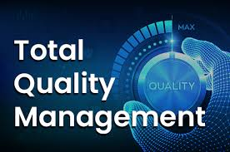
INTRODUCTION-
Total - made up of the whole.
Quality - degree of excellence a product or service provides.
Management - act, art or manner of planning, controlling, directing.
Therefore, TQM is the art of managing the whole to achieve excellence.

Slide 4
DEFINATION-
Total quality management (TQM) has been defined as an integrated organizational effort designed to improve quality at every level.
The process to produce a perfect product by a series of measures require an organized effort by the entire company to prevent or eliminate errors at every stage in production is called total quality management.
According to international organization for standards defined tqm as, “TQM is a management approach for an organization, centered on quality, based on the participation of all its members and aiming at long-term success through customer satisfaction and benefits to all members of the organization and to the society.

Slide 5
ROLE OF TQM IN HR-
Total Quality Management (TQM) plays a crucial role in Human Resources (HR) by fostering a culture of continuous improvement, enhancing employee satisfaction, and driving organizational performance.
Here are the key roles of TQM in HR:
1. Improving Recruitment and Talent Acquisition:
TQM helps optimize the recruitment process to attract and hire the best talent efficiently and effectively.
2. Enhancing Employee Training and Development:
TQM supports the creation of high-quality training programs that align with employee needs and business objectives.
3. Optimizing Performance Management:
TQM strengthens performance management by promoting continuous feedback, employee involvement, and alignment with organizational goals.
4. Improving Employee Satisfaction and Engagement:
TQM fosters a culture of quality that focuses on improving employee satisfaction and creating an environment where employees feel valued and motivated.

Slide 6
Integration of TQM in HR
The integration of Total Quality Management (TQM) in Human
Resources (HR) involves applying the principles of TQM to HR
practices .
Here are the key aspects of integrating TQM into HR:
Commitment to Quality and Continuous Improvement
Training and Development
Data-Driven Decision Making
Customer-Centric Approach
Benefits of TQM Integration in HR:
Improved Employee Engagement
Higher Productivity

Slide 7
-:Tools of TQM relevant to HR:-
Benchmarking
SWOT Analysis
Pareto Analysis
Brainstorming
PDCA

Slide 8
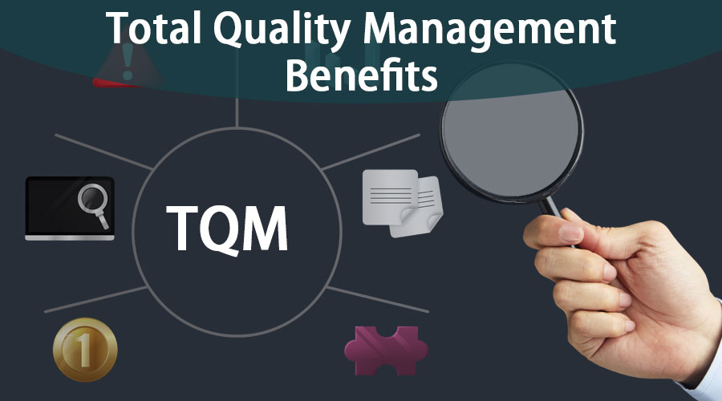
-:Benefit of TQM for HR:-
Enhance employee productivity
Reduced attrition rate
Improve communication
Customer satisfaction
Organization growth

Slide 9
CASE STUDY-
Toyota Motor Corporation is renowned for its strong focus on quality and lean manufacturing processes. During the 1990s, Toyota faced challenges with product defects and inefficiencies in production, leading to increased warranty claims and customer dissatisfaction.
Key Issues:
High Defect Rates.
Rising costs associated with warranty repairs.
Inefficient Processes
Losing market share to competitors with better quality products

Slide 10
Solutions And Outcomes:
Adoption of TQM Principles: Toyota embraced TQM by focusing on:
Customer focus: Prioritizing customer needs in every process.
Continuous improvement (Kaizen): Encouraging incremental improvements in all areas.
Employee involvement: Empowering employees to take ownership of quality initiatives.
Outcomes:
Reduced Defect Rates
Enhanced Operational Efficiency
Improved Customer Satisfaction
Employee Engagement
Sustained Competitive Advantage

Slide 11
CONCLUSION-
TQM encourages participation amongst employees, managers and organization as whole.
• Using Quality management reduces rework nearly to zero in an achievable goal. The responsibilities either its professional, social, legal one that rest with the pharmaceutical manufacturer for the assurance of quality of product are tremendous and it can only be achieved by well organized.
• Work culture and complete engagement of the employees at the work place. It should be realized that national & international regulations must be implemented systematically and process.
Control should be practiced rigorously.
• Thus quality is critically important ingredient to organizational success today which can be achieved by TQM, an organizational approach that focusses on quality as an over achieving goals, aimed at aimed at the prevention of defects rather than detection of defects.

